Slide 1
Network Layer – Part I
Computer Communications and Networks
ITCS 6166/8166
Dr. Dewan Tanvir Ahmed
Department of Computer Science
University of North Carolina at Charlotte

Slide 2


Chapter 4 Network Layer
Computer Networking: A Top Down Approach 6th edition Jim Kurose, Keith Ross Addison-Wesley March 2012
A note on the use of these ppt slides:
We’re making these slides freely available to all (faculty, students, readers). They’re in PowerPoint form so you see the animations; and can add, modify, and delete slides (including this one) and slide content to suit your needs. They obviously represent a lot of work on our part. In return for use, we only ask the following:
If you use these slides (e.g., in a class) that you mention their source (after all, we’d like people to use our book!)
If you post any slides on a www site, that you note that they are adapted from (or perhaps identical to) our slides, and note our copyright of this material.
Thanks and enjoy! JFK/KWR
All material copyright 1996-2012
J.F Kurose and K.W. Ross, All Rights Reserved

Slide 3
Chapter 4: outline
4.1 introduction
4.2 virtual circuit and datagram networks
4.3 what’s inside a router
4.4 IP: Internet Protocol
datagram format
IPv4 addressing
ICMP
IPv6
4.5 routing algorithms
link state
distance vector
hierarchical routing
4.6 routing in the Internet
RIP
OSPF
BGP
4.7 broadcast and multicast routing

Slide 4



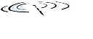










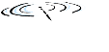


Network layer
application
transport
network
data link
physical
network layer protocols in every host and router
router examines header fields in all IP datagrams passing through it
network
data link
physical
network
data link
physical
network
data link
physical
network
data link
physical
network
data link
physical
network
data link
physical
network
data link
physical
network
data link
physical
network
data link
physical
application
transport
network
data link
physical
network
data link
physical
network
data link
physical

Slide 5
Two key network-layer functions
forwarding: refers to the router-local action of transferring a packet from an input link interface to the appropriate output link interface.
routing: refers to the network-wide process that determines the end-to-end paths that packets take from source to destination

Slide 6
Interplay between routing and forwarding
routing algorithm
routing algorithm determines
end-end-path through network
local forwarding table
header value
output link
0100
0101
0111
1001
3
2
2
1
forwarding table determines
local forwarding at this router
value in arriving
packet’s header
0111
1
3
2

Slide 7
Another function: Connection setup
3rd important function in some network architectures:
ATM, frame relay, MPLS
Require - the routers along the chosen path from source to destination to handshake with each other

Slide 8
Network service model
Services for individual datagrams:
Guaranteed delivery
Guaranteed delivery with bounded delay.
guaranteed delivery with less than 40 msec delay
Services for a flow of datagrams:
In-order datagram delivery
Guaranteed minimum bandwidth to flow
Restrictions on changes in inter-packet spacing (jitter)

Slide 9
Network layer service models:
Network
Architecture
Internet
ATM
ATM
ATM
Service
Model
best effort
CBR
VBR
ABR
Guarantees ?
Congestion
feedback
no (inferred
via loss)
no
congestion
no
congestion
yes
Bandwidth
none
constant
rate
guaranteed
rate
guaranteed
minimum
Loss
no
yes
yes
No
Order
no
yes
yes
Yes
Timing
no
yes
yes
no

Slide 10
Datagram forwarding table
routing algorithm
4 billion IP addresses, so rather than list individual destination address
list range of addresses
(aggregate table entries)
local forwarding table
dest address
output link
address-range 1
address-range 2
address-range 3
address-range 4
3
2
2
1
IP destination address in
arriving packet’s header
1
3
2

Slide 11
Datagram forwarding table
Destination Address Range
11001000 00010111 00010000 00000000
through
11001000 00010111 00010111 11111111
11001000 00010111 00011000 00000000
through
11001000 00010111 00011000 11111111
11001000 00010111 00011001 00000000
through
11001000 00010111 00011111 11111111
otherwise
Link Interface
0
1
2
3
Q: but what happens if ranges don’t divide up so nicely?

Slide 12
Longest prefix matching
longest prefix matching
when looking for forwarding table entry for given destination address, use longest address prefix that matches destination address.
Destination Address Range
11001000 00010111 00010*** *********
11001000 00010111 00011000 *********
11001000 00010111 00011*** *********
otherwise
Link interface
0
1
2
3
examples:
DA: 11001000 00010111 00010110 10100001
which interface?
DA: 11001000 00010111 00011000 10101010
which interface?

Slide 13
Chapter 4: outline
4.1 introduction
4.2 virtual circuit and datagram networks
4.3 IP: Internet Protocol
datagram format
IPv4 addressing
ICMP
IPv6

Slide 14
IP datagram header format
IP protocol version
number
32 bits
total datagram
length (bytes)
header length
(bytes)
head.
len
type of
service
ver
length
for
fragmentation/
reassembly
“type” of data
flgs
fragment
offset
16-bit identifier
max number
remaining hops
(decremented at
each router)
time to
live
upper
layer
header
checksum
32 bit source IP address
upper layer protocol
to deliver payload to
32 bit destination IP address
options (if any)
e.g. timestamp,
record route
taken, specify
list of routers
to visit.
data
(variable length,
typically a TCP
or UDP segment)

Slide 15
IP datagram format
IP protocol version
number
32 bits
ver
head.
len
type of
service
length
Version number.
4 bits specify the IP protocol version of the datagram.
By looking at the version number, the router can determine how to interpret the remainder of the IP datagram.
flgs
fragment
offset
16-bit identifier
time to
live
upper
layer
header
checksum
32 bit source IP address
32 bit destination IP address
options (if any)
data
(variable length,
typically a TCP
or UDP segment)

Slide 16
IP datagram format
header length
(bytes)
32 bits
Header length.
Because an IPv4 datagram can contain a variable number of options (which are included in the IPv4 datagram header),
Helps to determine where in the IP datagram the data actually begins.
Most IP datagrams do not contain options.
The typical IP datagram has a 20- byte header.
ver
head.
len
type of
service
length
flgs
fragment
offset
16-bit identifier
time to
live
upper
layer
header
checksum
32 bit source IP address
32 bit destination IP address
options (if any)
data
(variable length,
typically a TCP
or UDP segment)

Slide 17
IP datagram format
“type” of data
32 bits
Type of Service
8-bit length which allow different types of IP datagrams to be distinguished from each other.
E.g., datagrams particularly requiring low delay, high throughput, or reliability
might be useful to distinguish real- time datagrams, IP telephony application, from non- real- time traffic, FTP.
ver
head.
len
type of
service
length
flgs
fragment
offset
16-bit identifier
time to
live
upper
layer
header
checksum
32 bit source IP address
32 bit destination IP address
options (if any)
data
(variable length,
typically a TCP
or UDP segment)

Slide 18
IP datagram format
total datagram
length (bytes)
32 bits
ver
head.
len
type of
service
length
Datagram Length
The total length of the IP datagram = header plus data (in bytes).
16 bits, so the theoretical maximum size = 65,535 bytes.
datagrams are rarely larger than 1,500 bytes.
flgs
fragment
offset
16-bit identifier
time to
live
upper
layer
header
checksum
32 bit source IP address
32 bit destination IP address
options (if any)
data
(variable length,
typically a TCP
or UDP segment)

Slide 19
IP datagram format
32 bits
ver
head.
len
type of
service
length
Identifier, flags, fragmentation offset.
Will discuss later
IPv6 does not allow fragmentation at routers.
flgs
fragment
offset
16-bit identifier
time to
live
upper
layer
header
checksum
32 bit source IP address
32 bit destination IP address
options (if any)
data
(variable length,
typically a TCP
or UDP segment)

Slide 20
IP datagram format
32 bits
ver
head.
len
type of
service
length
Time- to- live.
to ensure that datagrams do not circulate forever
decremented by one each time the datagram is processed by a router.
If TTL == 0, the datagram must be dropped.
flgs
fragment
offset
16-bit identifier
time to
live
upper
layer
header
checksum
32 bit source IP address
32 bit destination IP address
options (if any)
data
(variable length,
typically a TCP
or UDP segment)

Slide 21
IP datagram format
Upper layer Protocol
This field is used only when an IP datagram reaches its final destination.
The value of this field indicates the specific transport-layer protocol to which the data portion of this IP datagram should be passed.
6 => TCP; UDP => 17
http://www.iana.org/assignments/protocol-numbers/protocol-numbers.xhtml
32 bits
ver
head.
len
type of
service
length
flgs
fragment
offset
16-bit identifier
time to
live
upper
layer
header
checksum
32 bit source IP address
32 bit destination IP address
options (if any)
data
(variable length,
typically a TCP
or UDP segment)

Slide 22
IP datagram format
32 bits
Header Checksum
The header checksum aids a router in detecting bit errors in a received IP datagram.
Routers typically discard datagrams for which an error has been detected.
head.
len
type of
service
ver
length
flgs
fragment
offset
16-bit identifier
time to
live
upper
layer
header
checksum
32 bit source IP address
32 bit destination IP address
options (if any)
data
(variable length,
typically a TCP
or UDP segment)

Slide 23
IP datagram format
Why does TCP/IP perform error checking at both the transport and network layers?
First, only the IP header is check summed at the IP layer, while the TCP/UDP checksum is computed over the entire TCP/UDP segment.
Second, TCP/ UDP and IP do not necessarily both have to belong to the same protocol stack.
TCP can, in principle, run over a different protocol ( for example, ATM) and
IP can carry data that will not be passed to TCP/ UDP.

Slide 24
IP datagram format
32 bits
ver
head.
len
type of
service
length
flgs
fragment
offset
16-bit identifier
IP Address:
Often the source host determines the destination address via a DNS lookup,
time to
live
upper
layer
header
checksum
32 bit source IP address
32 bit destination IP address
options (if any)
data
(variable length,
typically a TCP
or UDP segment)

Slide 25
IP datagram format
32 bits
ver
head.
len
type of
service
length
flgs
fragment
offset
16-bit identifier
Payload
In most circumstances, the data field of the IP datagram contains the transport-layer segment (TCP or UDP) to be delivered to the destination.
However, the data field can carry other types of data, such as ICMP messages
time to
live
upper
layer
header
checksum
32 bit source IP address
32 bit destination IP address
options (if any)
data
(variable length,
typically a TCP
or UDP segment)

Slide 26
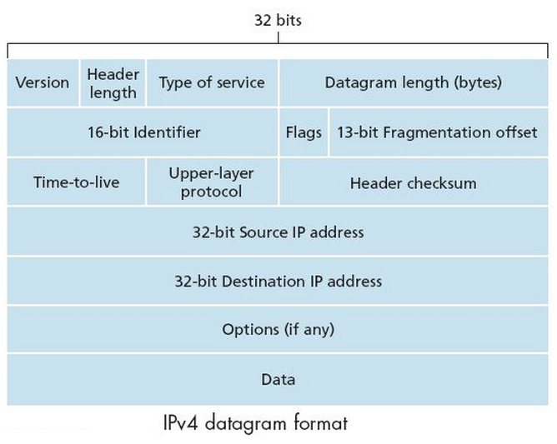
IP datagram format
how much overhead?
20 bytes of TCP
20 bytes of IP
= 40 bytes + app layer overhead

Slide 27

IP fragmentation, reassembly
Network links have MTU (max transfer size) - largest possible link-level frame
different link types, different MTUs
Large IP datagram divided (“fragmented”) within net
one datagram becomes several datagrams
“reassembled” only at final destination, not at router
IP header bits used to identify, order related fragments
fragmentation:
in: one large datagram
out: 3 smaller datagrams
…
reassembly
…

Slide 28
IP fragmentation, reassembly
length
=4000
ID
=x
fragflag
=0
offset
=0
example:
4000 byte datagram
MTU = 1500 bytes
one large datagram becomes
several smaller datagrams
1480 bytes in data field
length
=1500
ID
=x
fragflag
=1
offset
=0
length
=1500
ID
=x
fragflag
=1
offset
=185
offset = 1480/8
length
=1040
ID
=x
fragflag
=0
offset
=370

Slide 29
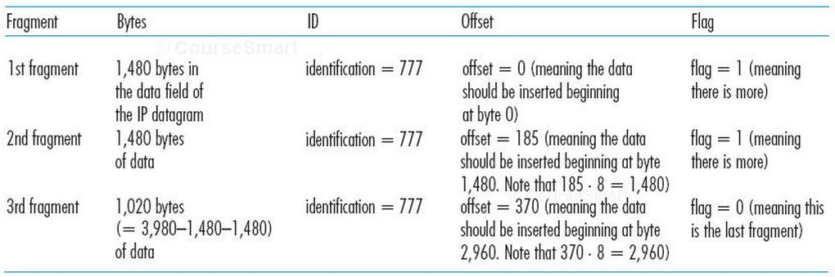
IP fragmentation, reassembly

Slide 30
Chapter 4: outline
4.1 introduction
4.2 virtual circuit and datagram networks
4.3 what’s inside a router
4.4 IP: Internet Protocol
datagram format
IPv4 addressing
ICMP
IPv6
4.5 routing algorithms
link state
distance vector
hierarchical routing
4.6 routing in the Internet
RIP
OSPF
BGP
4.7 broadcast and multicast routing

Slide 31
IP addressing: introduction
223.1.1.1
IP address: 32-bit identifier for host, router interface
interface: connection between host/router and physical link
router’s typically have multiple interfaces
host typically has one or two interfaces (e.g., wired Ethernet, wireless 802.11)
IP addresses associated with each interface
223.1.2.1
223.1.1.2
223.1.1.4
223.1.2.9
223.1.1.3
223.1.3.27
223.1.2.2
223.1.3.1
223.1.3.2
223.1.1.1 = 11011111 00000001 00000001 00000001
223
1
1
1

Slide 32

IP addressing: introduction
223.1.1.1
Q: how are interfaces actually connected?
A: we’ll learn about that in chapter 5, 6.
223.1.2.1
223.1.1.2
223.1.1.4
223.1.2.9
223.1.1.3
223.1.3.27
223.1.2.2
A: wired Ethernet interfaces connected by Ethernet switches
223.1.3.1
223.1.3.2
For now: don’t need to worry about how one interface is connected to another (with no intervening router)
A: wireless WiFi interfaces connected by WiFi base station

Slide 33
Subnets
IP address:
subnet part - high order bits
host part - low order bits
What’s a subnet ?
device interfaces with same subnet part of IP address
can physically reach each other without intervening router
223.1.1.1
223.1.1.2
223.1.2.1
223.1.1.4
223.1.2.9
223.1.2.2
223.1.1.3
223.1.3.27
subnet
223.1.3.1
223.1.3.2
network consisting of 3 subnets

Slide 34
Subnets
223.1.1.0/24
223.1.2.0/24
recipe
to determine the subnets, detach each interface from its host or router, creating islands of isolated networks
each isolated network is called a subnet
223.1.1.1
223.1.1.2
223.1.2.1
223.1.1.4
223.1.2.9
223.1.2.2
223.1.1.3
223.1.3.27
subnet
223.1.3.1
223.1.3.2
223.1.3.0/24
subnet mask: /24

Slide 35
Subnets
223.1.1.2
how many?
223.1.1.1
223.1.1.4
223.1.1.3
223.1.9.2
223.1.7.0
223.1.9.1
223.1.7.1
223.1.8.1
223.1.8.0
223.1.2.6
223.1.3.27
223.1.2.1
223.1.2.2
223.1.3.1
223.1.3.2

Slide 36
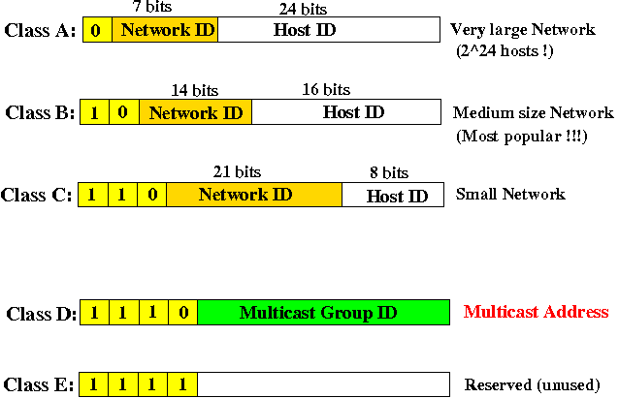
IP Addresses and Class

Slide 37
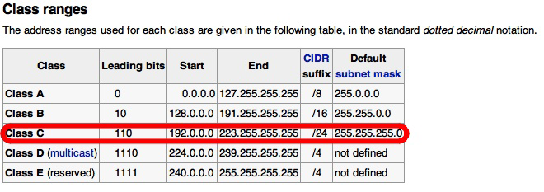
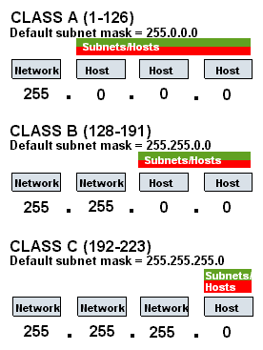
IP Addresses and Class

Slide 38
subnetting
subnetting divides the network into small subnets. Routers are used to communicate between subnets, whereas each subnet allows its linked devices to communicate with each other.
The size of a subnet is determined by the network technology used and the connection needs. Within the restrictions of the address space available for its usage, each organization is responsible for determining the number and size of the subnets it generates.
.

Slide 39
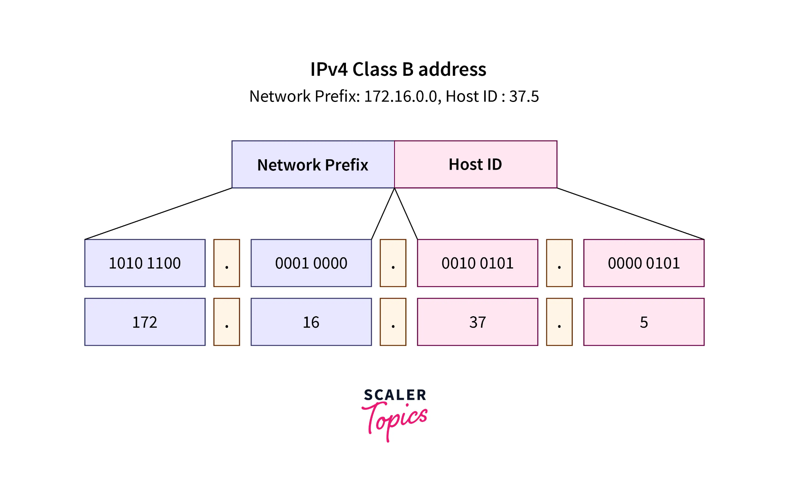
Let's understand how subnetting splits a network into subnets.
A Network Prefix (also known as the Network ID) and a Host ID are the two fields that make up an IP address. Whether the Network Prefix and the Host ID are separated depends on whether the address is Class A, B, or C. The figure given below shows a 172.16.37.5 IPv4 Class B address. The Host ID is 37.5, and the Network Prefix is 172.16.0.0.
IPV4

Slide 40
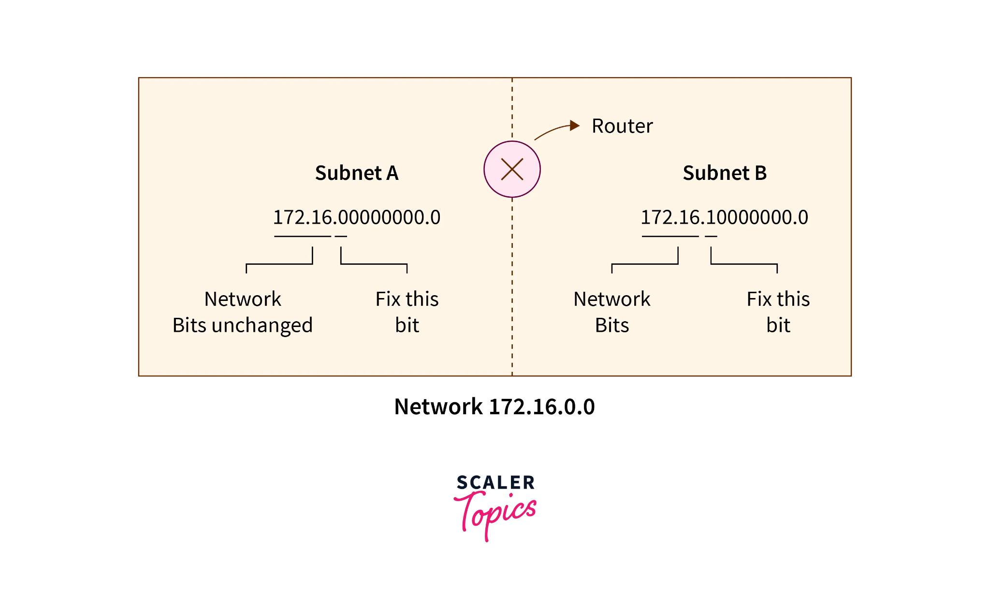
Now, we generally fix MSB(Most Significant Bit) bits of the Host ID to generate the subnets. In the figure below, we fix one of the host's MSB(Most Significant Bit) bits to generate two network subnets. We cannot change network bits because if we change network bits, the whole network is changed.
cont..

Slide 41
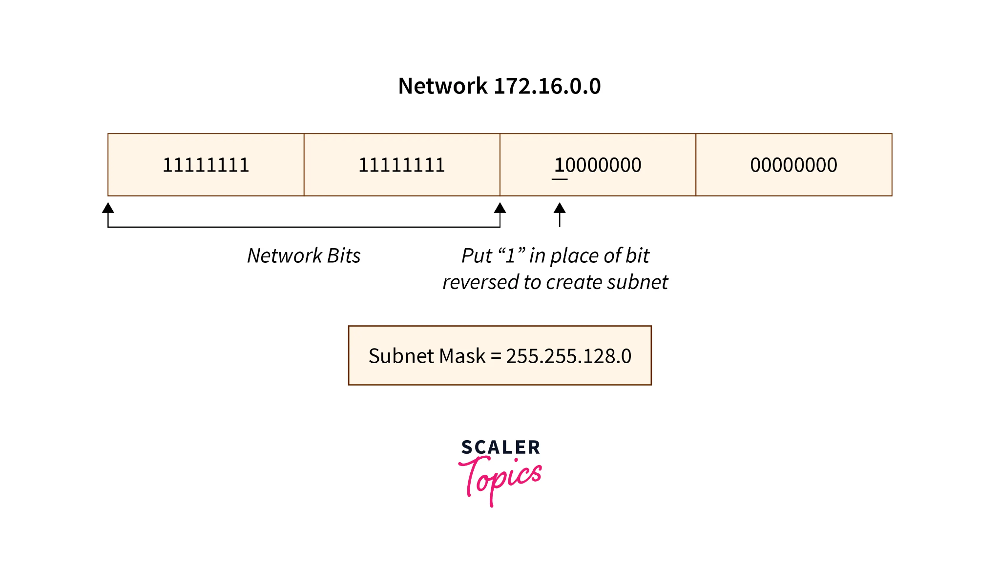
.
To identify a subnet, we need a subnet mask which is calculated by putting ‘1’ in place of all Network ID bits and the number of bits we reserve in Host ID to generate the subnet. The subnet mask aims to route the data packet from the internet to its desired subnet network. A subnet mask also specifies which portion of an address should be utilized as the Subnet ID.
.
cont…

Slide 42
.
If we want to generate variable-length subnets, then we apply permutations on the number of bits reserved to create subnets. This subnetting is called Variable Length Subnet Masking (VLSM).
The broadcast address of a subnet is calculated by making all the remaining bits as‘1’of Host Id after having some bits reserved to represent the subnet.The broadcast address is used to broadcast the message to all the network hosts.

Slide 43
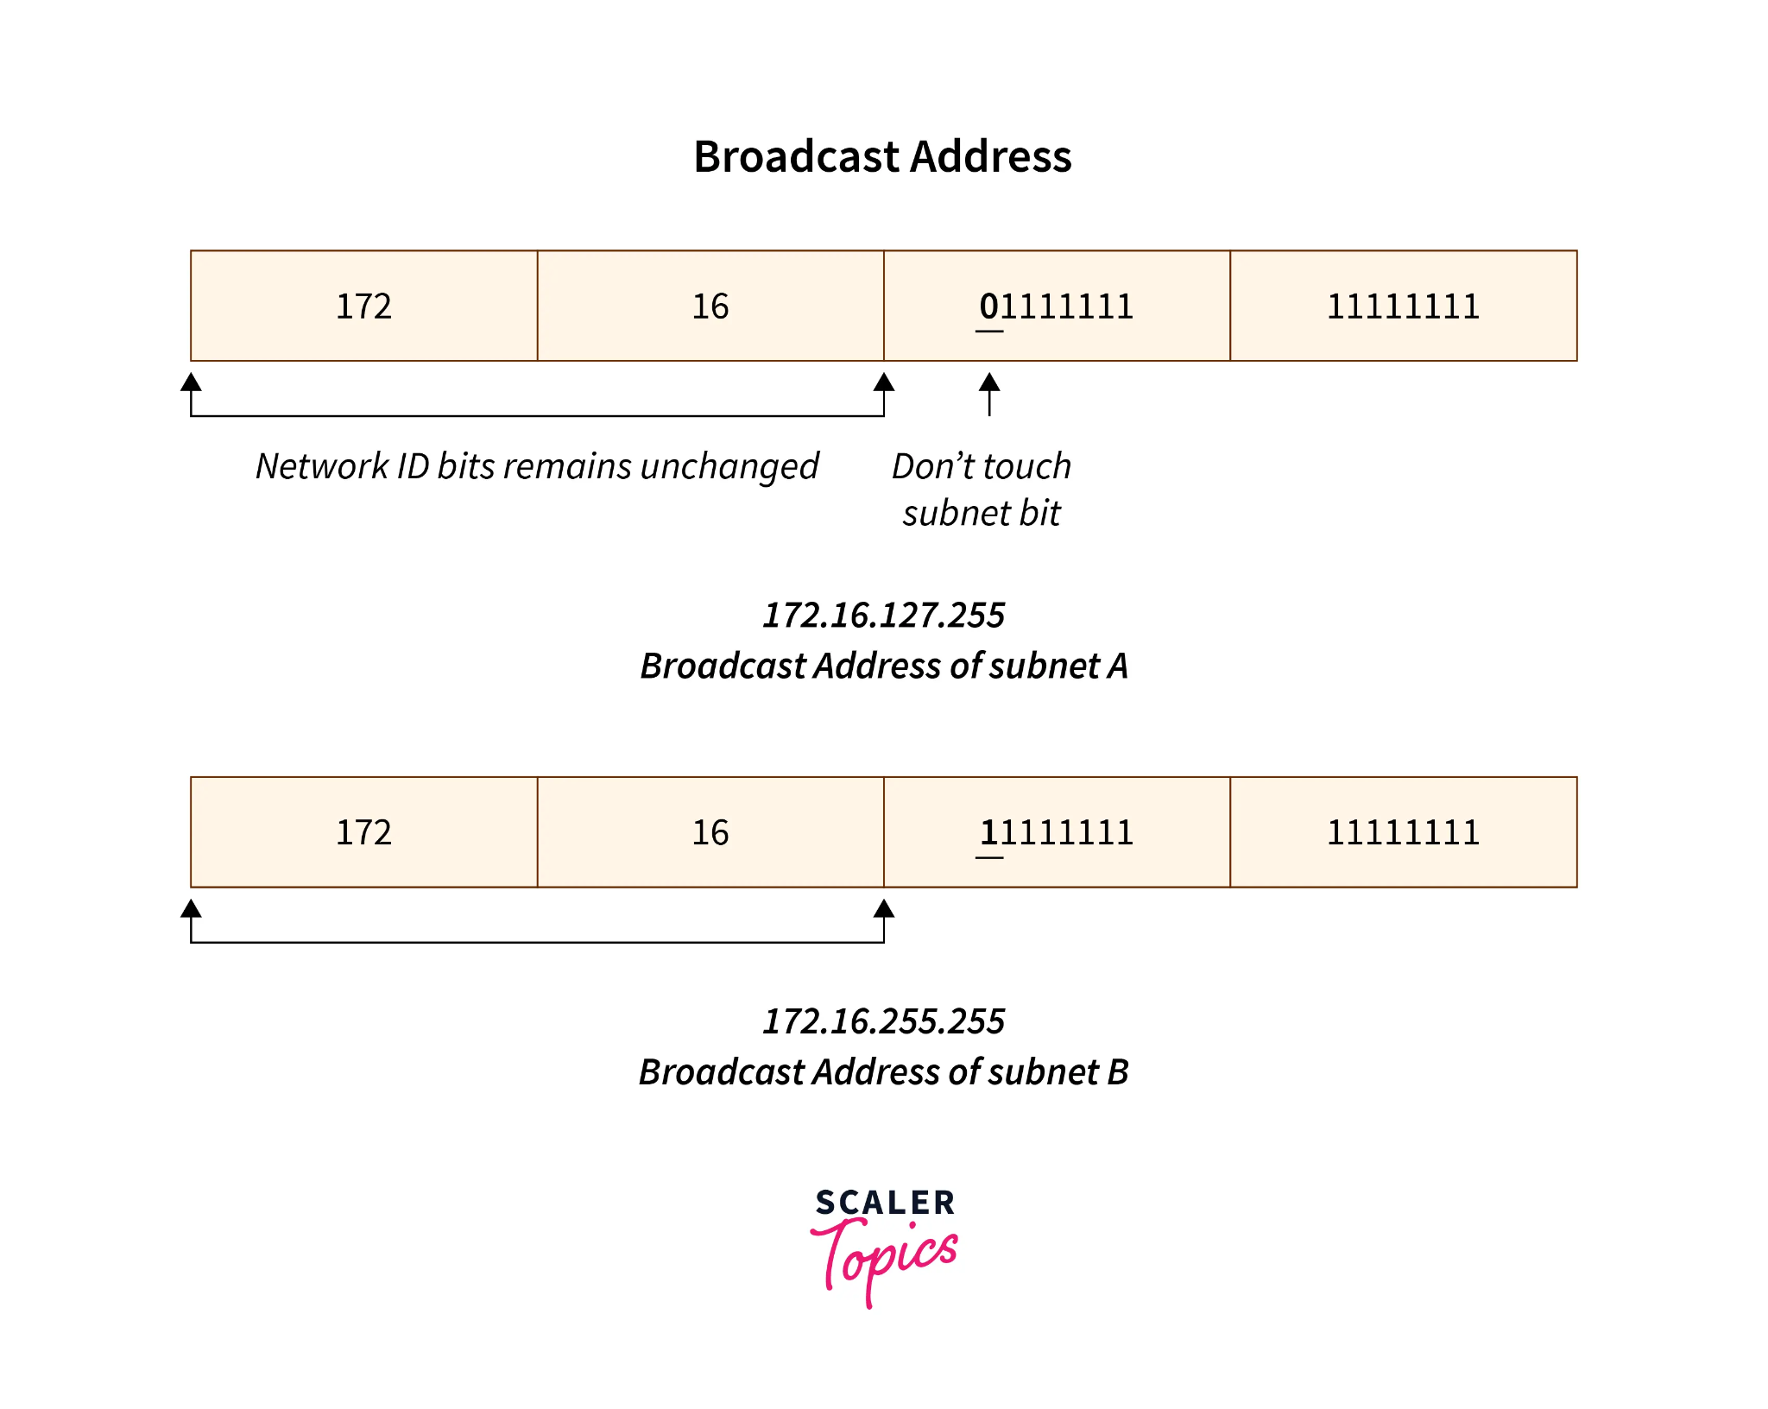
subnetting

Slide 44
Supernetting
Supernetting is the procedure of combining multiple subnetworks into one network. The process of Supernetting is just the inverse of subnetting. In the process of Supernetting, bits of the network are converted into bits of the host
Supernetting is performed by the Internet service provider to achieve the most efficient allocation of the IP address.
Classless Inter-Domain Routing(CIDR) supported Routing protocols are the requirement of Supernetting.

Slide 45
IP addressing: CIDR
CIDR: Classless InterDomain Routing
CIDR generalizes the notion of subnet addressing
subnet portion of address of arbitrary length
address format: a.b.c.d/x, where x is # bits in subnet portion of address
subnet
part
host
part
11001000 00010111 00010000 00000000
200.23.16.0/23

Slide 46
IP addresses: how to get one?
Q: How does a router get IP address?
A system administrator will typically manually configure the IP addresses into the router

Slide 47
IP addresses: how to get one?
Q: How does a host get IP address?
hard-coded by system admin in a file
Windows: control-panel->network->configuration->tcp/ip->properties
UNIX: /etc/rc.config
DHCP: Dynamic Host Configuration Protocol: dynamically get address from as server
“plug-and-play”
DHCP also allows a host to learn additional information
its subnet mask
the address of its first- hop router ( often called the default gateway), and
the address of its local DNS server.

Slide 48
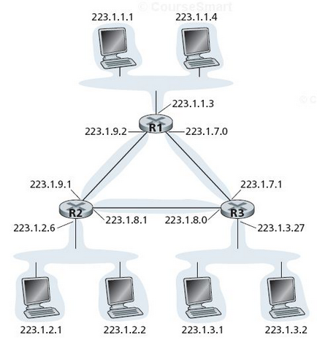
DHCP: Dynamic Host Configuration Protocol
In the simplest case, each subnet will have a DHCP server.
If no server is present on the subnet, a DHCP relay agent that knows the address of a DHCP server for that network is needed.
typically a router

Slide 49
DHCP: Dynamic Host Configuration Protocol
goal: allow host to dynamically obtain its IP address from network server when it joins network
can renew its lease
allows reuse of addresses
support for mobile users
DHCP overview:
host broadcasts “DHCP discover” msg [optional]
DHCP server responds with “DHCP offer” msg [optional]
host requests IP address: “DHCP request” msg
DHCP server sends address: “DHCP ack” msg

Slide 50
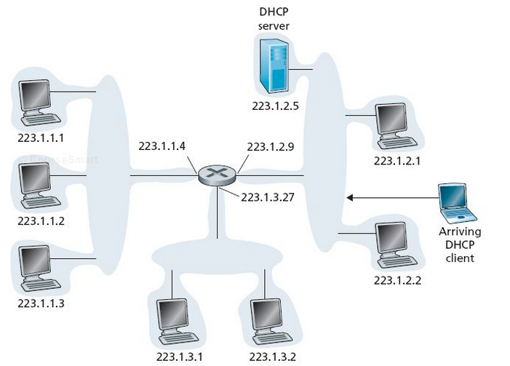
DHCP client-server scenario
DHCP server attached to subnet 223.1.2/24
arriving DHCP client needs address in this network
the router serving as the relay agent for arriving clients attached to subnets 223.1.1/24 and 223.1.3/24.

Slide 51
DHCP – Four Steps Process
DHCP Server Discovery
Find a DHCP server with which to interact.
Send a DHCP discover message
a UDP packet to port 67.
But to whom should this datagram be sent?
doesn’t know the IP address of the network to which it is attaching
The DHCP client creates an IP datagram containing with
the broadcast destination IP address of 255.255.255.255 and a “ this host” source IP address of 0.0.0.0.
The DHCP client passes the IP datagram to the link layer, which then broadcasts this frame to all nodes attached to the subnet

Slide 52
DHCP – Four Steps Process
DHCP Server Offers
DHCP offer message is broadcast to all nodes on the subnet
IP broadcast address of 255.255.255.255.
Since several DHCP servers can be present on the subnet and the client able to choose from among several offers.
Each server offer message contains
the transaction ID of the received discover message
the proposed IP address for the client,
the network mask, and
an IP address lease time— the amount of time for which the IP address will be valid.
lease time can be several hours or days

Slide 53
DHCP – Four Steps Process
DHCP request
The newly arriving client will choose from among one or more server offers and respond to its selected offer with a DHCP request message
Echoing back the configuration parameters.
DHCP ACK
The server responds to the DHCP request message with a DHCP ACK message and
Confirming the requested parameters.

Slide 54

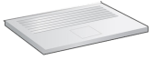
DHCP client-server scenario
DHCP server: 223.1.2.5
DHCP discover
arriving
client
find a DHCP server with which to interact.
src : 0.0.0.0, 68
dest.: 255.255.255.255,67
yiaddr: 0.0.0.0
transaction ID: 654
DHCP offer
src: 223.1.2.5, 67
dest: 255.255.255.255, 68
yiaddrr: 223.1.2.4
transaction ID: 654
lifetime: 3600 secs
DHCP request
src: 0.0.0.0, 68
dest:: 255.255.255.255, 67
yiaddrr: 223.1.2.4
transaction ID: 655
lifetime: 3600 secs
DHCP ACK
src: 223.1.2.5, 67
dest: 255.255.255.255, 68
yiaddrr: 223.1.2.4
transaction ID: 655
lifetime: 3600 secs

Slide 55
IP addresses: how to get one?
Q: How does network get subnet part of IP addr?
A: gets allocated portion of its provider ISP’s address space
ISP's block 11001000 00010111 00010000 00000000 200.23.16.0/20
Organization 0 11001000 00010111 00010000 00000000 200.23.16.0/23
Organization 1 11001000 00010111 00010010 00000000 200.23.18.0/23
Organization 2 11001000 00010111 00010100 00000000 200.23.20.0/23
... ….. …. ….
Organization 7 11001000 00010111 00011110 00000000 200.23.30.0/23

Slide 56
Hierarchical addressing: route aggregation
Hierarchical addressing allows efficient advertisement of routing information:
Organization 0
200.23.16.0/23
Organization 1
200.23.18.0/23
“Send me anything
with addresses
beginning
200.23.16.0/20”
Organization 2
200.23.20.0/23
.
Fly-By-Night-ISP
.
.
.
.
Internet
Organization 7
.
200.23.30.0/23
ISPs-R-Us
“Send me anything
with addresses
beginning
199.31.0.0/16”

Slide 57
IP addressing: the last word...
Q: How does an ISP get block of addresses?
A: ICANN: Internet Corporation for Assigned Names and Numbers http://www.icann.org/
Allocates addresses
Manages DNS
Assigns domain names, resolves disputes

Slide 58
NAT: network address translation
Motivation: Local network uses just one IP address as far as outside world is concerned:
Range of addresses not needed from ISP: just one IP address for all devices
Can change addresses of devices in local network without notifying outside world
Can change ISP without changing addresses of devices in local network
Devices inside local net not explicitly addressable (a security plus)

Slide 59
NAT: network address translation
rest of
Internet
local network
(e.g., home network)
10.0.0/24
10.0.0.1
10.0.0.4
10.0.0.2
138.76.29.7
10.0.0.3
all datagrams leaving local
network have same single source NAT IP address: 138.76.29.7,different source port numbers
datagrams with source or
destination in this network
have 10.0.0/24 address for
source, destination (as usual)

Slide 60
NAT: network address translation
Implementation: NAT router must:
Outgoing datagrams: replace (source IP address, port #) of every outgoing datagram to (NAT IP address, new port #)
. . . remote clients/servers will respond using (NAT IP address, new port #) as destination addr
Remember (in NAT translation table) every (source IP address, port #) to (NAT IP address, new port #) translation pair
Incoming datagrams: replace (NAT IP address, new port #) in dest fields of every incoming datagram with corresponding (source IP address, port #) stored in NAT table

Slide 61
NAT: network address translation
NAT translation table
WAN side addr LAN side addr
2: NAT router
changes datagram
source addr from
10.0.0.1, 3345 to
138.76.29.7, 5001,
updates table
1: host 10.0.0.1
sends datagram to
128.119.40.186, 80
138.76.29.7, 5001 10.0.0.1, 3345
…… ……
S: 10.0.0.1, 3345
D: 128.119.40.186, 80
10.0.0.1
1
2
S: 138.76.29.7, 5001
D: 128.119.40.186, 80
10.0.0.4
10.0.0.2
138.76.29.7
S: 128.119.40.186, 80
D: 10.0.0.1, 3345
4
S: 128.119.40.186, 80
D: 138.76.29.7, 5001
3
4: NAT router
changes datagram
dest addr from
138.76.29.7, 5001 to 10.0.0.1, 3345
10.0.0.3
3: reply arrives
dest. address:
138.76.29.7, 5001

Slide 62
NAT: network address translation
16-bit port-number field:
60,000 simultaneous connections with a single LAN-side address!
NAT is controversial:
Routers should only process up to layer 3
Violates end-to-end argument
Address shortage should instead be solved by IPv6

Slide 63
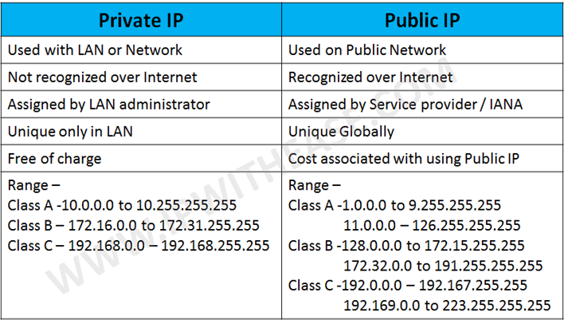

Slide 64
IPV6 Design Goals:
IPV4 was very successful ,but the limited addresses pose problems
Routing information were not inherent in addresses (if there is geographical info inbuilt in it, then routing becomes easier)
Experience had shown that some aspects of IPV4 are problematic: option headers, fragments

Slide 65
Simplifications for IPV6
Move to 128-bit addresses
Assign a fixed format to all headers
Remove the header checksum
Use “extension headers” rather than options
Remove the hop-by-hop segmentation procedure.

Slide 66
19-2 IPv6 ADDRESSES
Despite all short-term solutions, address depletion is still a long-term problem for the Internet. This and other problems in the IP protocol itself have been the motivation for IPv6.
Topics discussed in this section:
Structure Address Space

Slide 67

Note
An IPv6 address is 128 bits long.

Slide 68
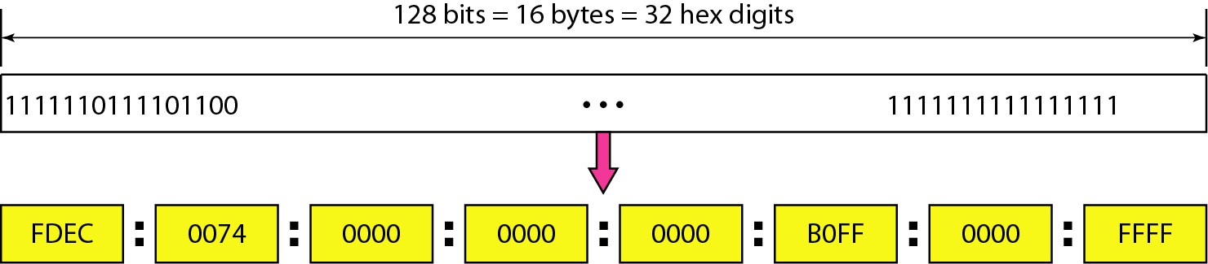
Figure 19.14 IPv6 address in binary and hexadecimal colon notation

Slide 69
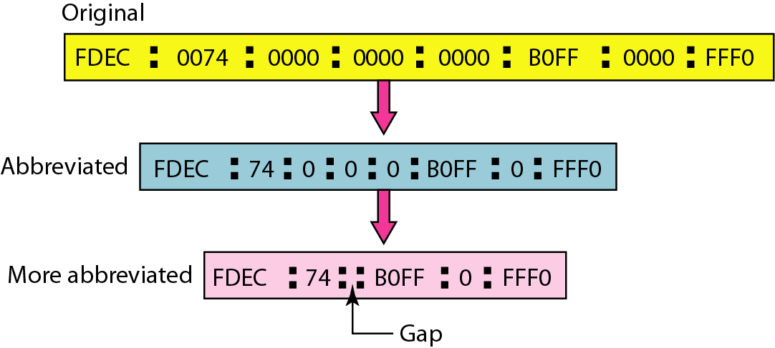
Figure 19.15 Abbreviated IPv6 addresses

Slide 70
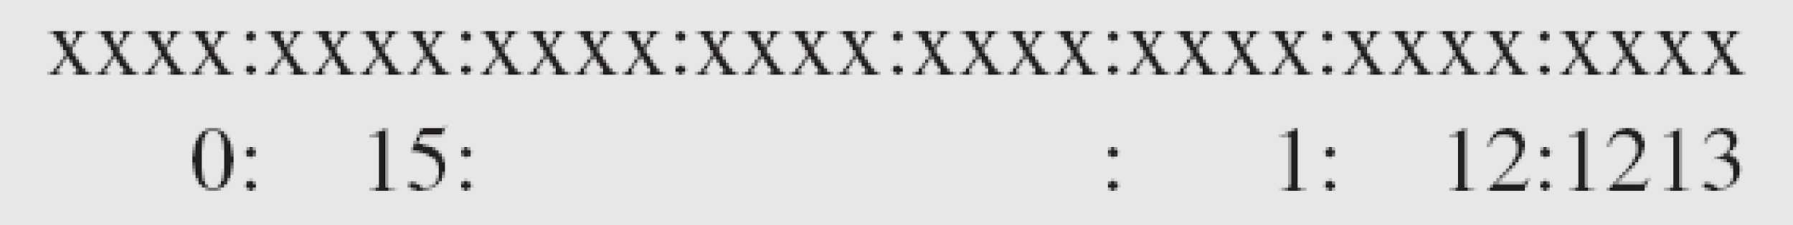
Example 19.11
Expand the address 0:15::1:12:1213 to its original.
Solution
We first need to align the left side of the double colon to the left of the original pattern and the right side of the double colon to the right of the original pattern to find how many 0s we need to replace the double colon.
This means that the original address is.

Slide 71
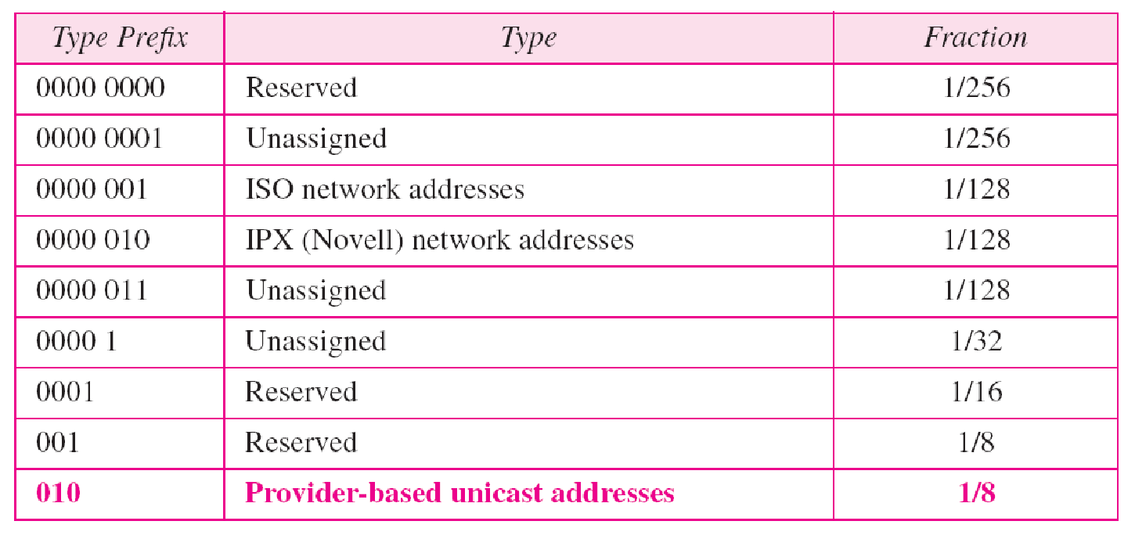
Table 19.5 Type prefixes for IPv6 addresses

Slide 72
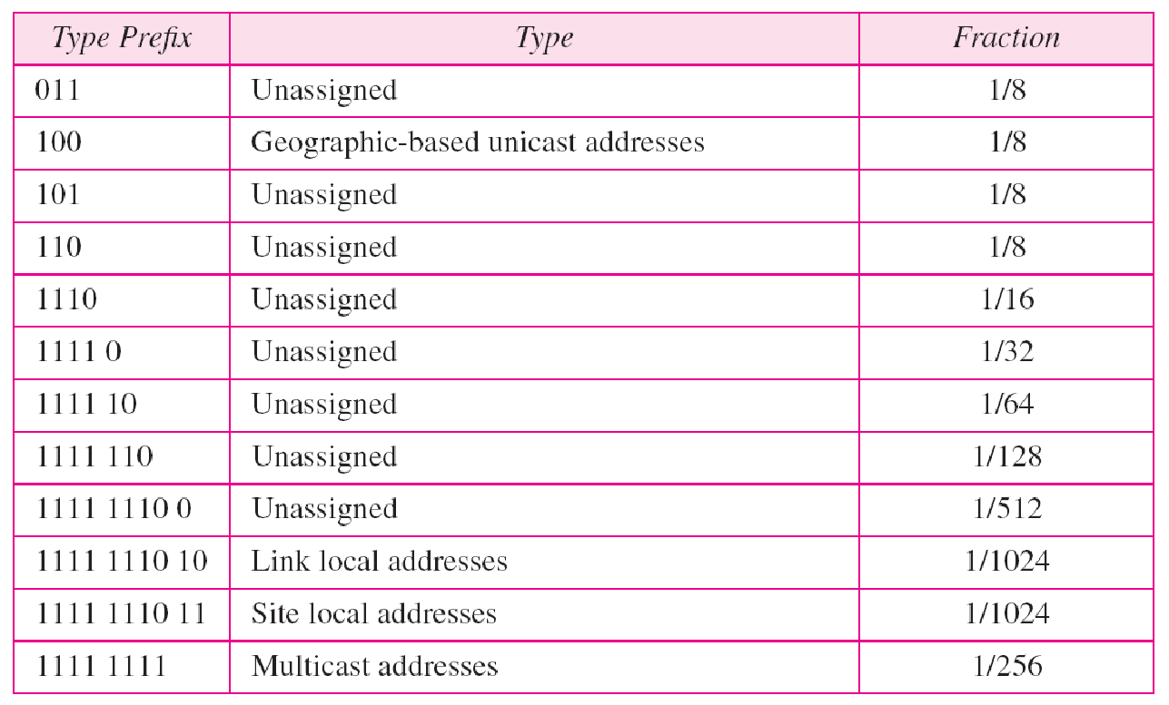
Table 19.5 Type prefixes for IPv6 addresses (continued)

Slide 73
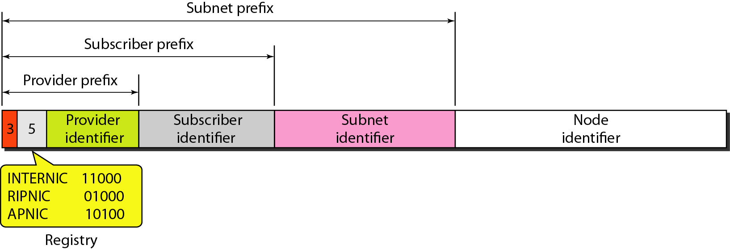
Figure 19.16 Prefixes for provider-based unicast address

Slide 74
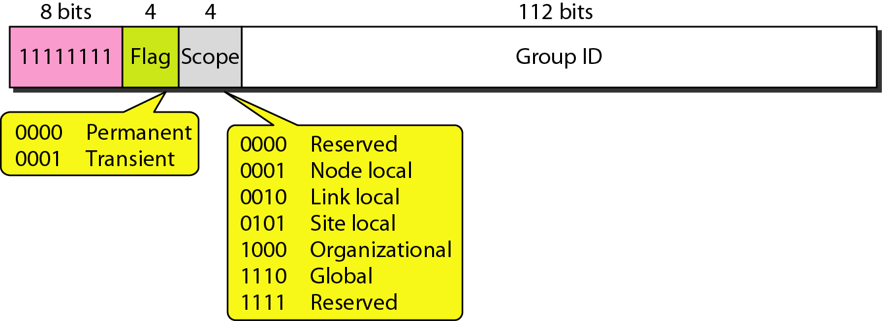
Figure 19.17 Multicast address in IPv6

Slide 75
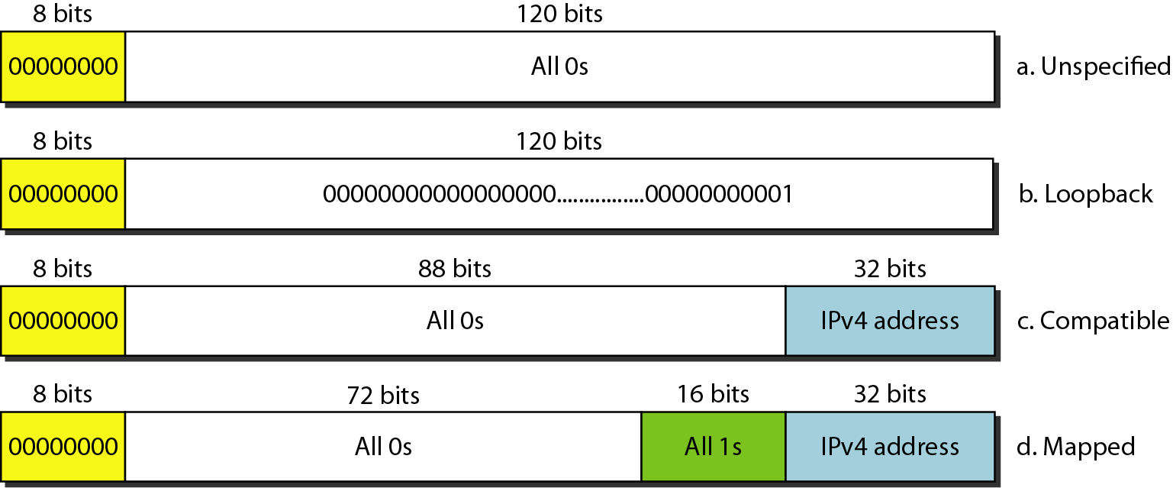
Figure 19.18 Reserved addresses in IPv6

Slide 76
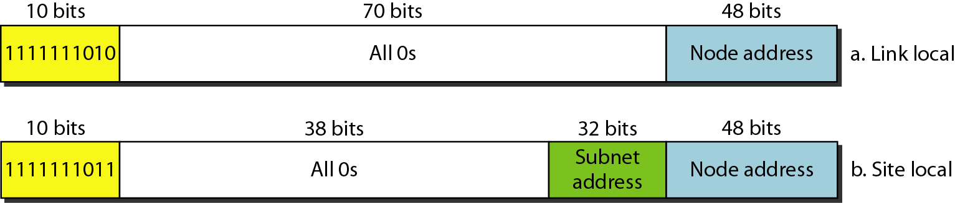
Figure 19.19 Local addresses in IPv6

Slide 77
21-1 ADDRESS MAPPING
The delivery of a packet to a host or a router requires two levels of addressing: logical and physical. We need to be able to map a logical address to its corresponding
physical address and vice versa. This can be done by using either static or dynamic mapping.
Topics discussed in this section:
Mapping Logical to Physical Address
Mapping Physical to Logical Address

Slide 78
Anytime a host or a router has an IP datagram to send to another host or router, it has the logical (IP) address of the receiver.
But the IP datagram must be encapsulated in a frame to be able to pass through the physical network. This means that the sender needs the physical address of the receiver.
The host or the router sends an ARP query packet. The packet includes the physical and IP addresses of the sender and the IP address of the receiver.

Slide 79
Because the sender does not know the physical address of the receiver, the query is broadcast over the network.
Every host or router on the network receives and processes the ARP query packet, but only the intended recipient recognizes its IP address and sends back an ARP response packet.
The response packet contains the recipient's IP and physical addresses.
The packet is unicast directly to the inquirer by using the physical address received in the query packet.

Slide 80
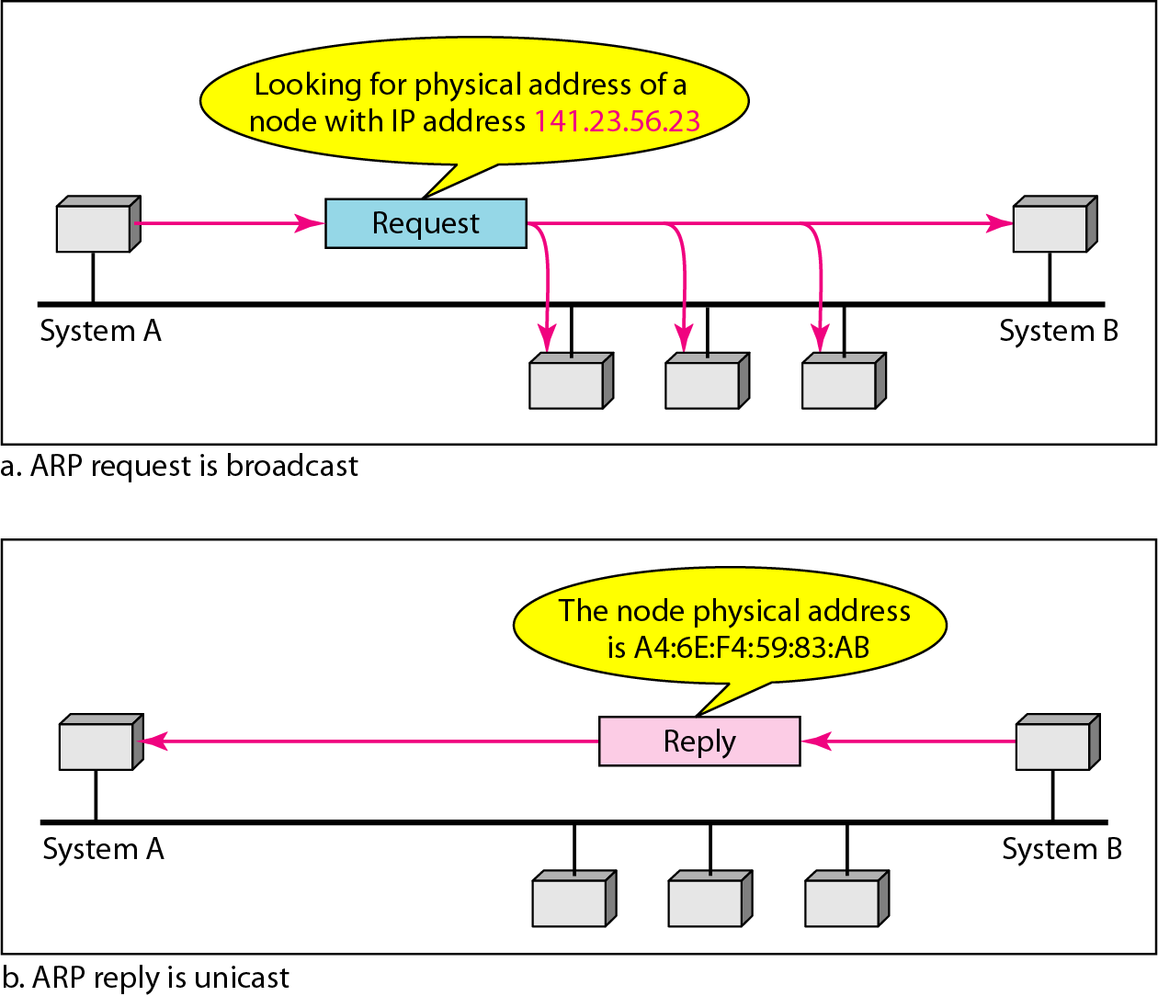
Figure 21.1 ARP operation

Slide 81
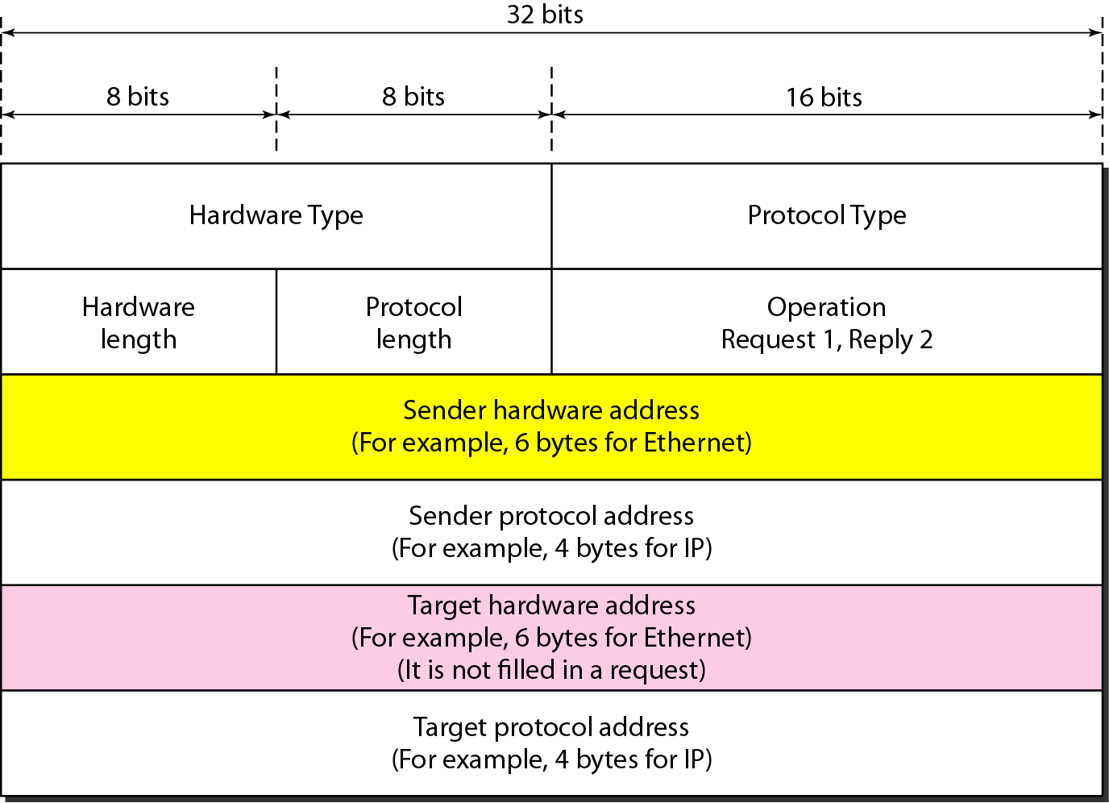
Figure 21.2 ARP packet

Slide 82
Hardware type- This is a 16-bit field defining the type of the network on which ARP is running. Each LAN has been assigned an integer based on its type. For example, Ethernet is given type 1. ARP can be used on any physical network.
Protocol type-This is a 16-bit field defining the protocol. For example, the value of this field for the IPv4 protocol is 080016, ARP can be used with any higher-level protocol.
Hardware length- This is an 8-bit field defining the length of the physical address in bytes. For example, for Ethernet the value is 6.
Protocol length-This is an 8-bit field defining the length of the logical address in bytes. For example, for the IPv4 protocol the value is 4.

Slide 83
Operation-This is a 16-bit field defining the type of packet. Two packet types are defined: ARP request and ARP reply
Sender hardware address- This is a variable-length field defining the physical
address of the sender-For example, for Ethernet this field is 6 bytes long.
Sender protocol address-This is a variable-length field defining the logical (for example, IP) address of the sender. For the IP protocol, this field is 4 bytes long.
Target hardware address-This is a variable-length field defining the physical address of the target. For example, for Ethernet this field is 6 bytes long. For an ARP request message, this field is alIOs because the sender does not know the physical address of the target.
Target protocol address-This is a variable-length field defining the logical (for example, IP) address of the target. For the IPv4 protocol, this field is 4 bytes long.

Slide 84
Encapsulation
An ARP packet is encapsulated directly into a data link frame. For example, in Fig an ARP packet is encapsulated in an Ethernet frame.
Note that the type field indicates that the data carried by the frame are an ARP packet.

Slide 85
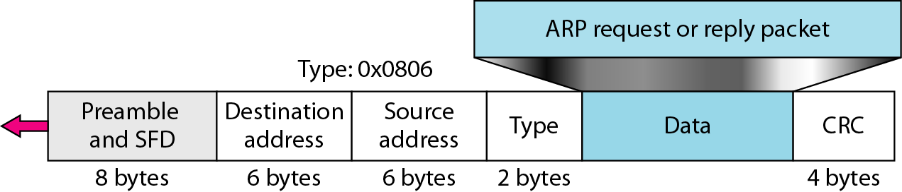
Figure 21.3 Encapsulation of ARP packet

Slide 86
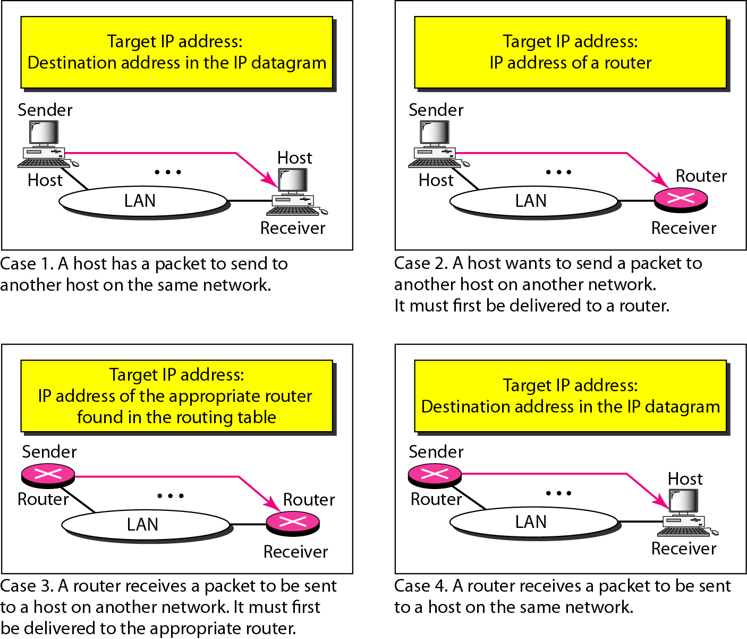
Figure 21.4 Four cases using ARP

Slide 87
Note
An ARP request is broadcast; an ARP reply is unicast.

Slide 88
Example 21.1
A host with IP address 130.23.43.20 and physical address B2:34:55:10:22:10 has a packet to send to another host with IP address 130.23.43.25 and physical address A4:6E:F4:59:83:AB. The two hosts are on the same Ethernet network. Show the ARP request and reply packets encapsulated in Ethernet frames.
Solution
Figure 21.5 shows the ARP request and reply packets. Note that the ARP data field in this case is 28 bytes, and that the individual addresses do not fit in the 4-byte boundary. That is why we do not show the regular 4-byte boundaries for these addresses.

Slide 89
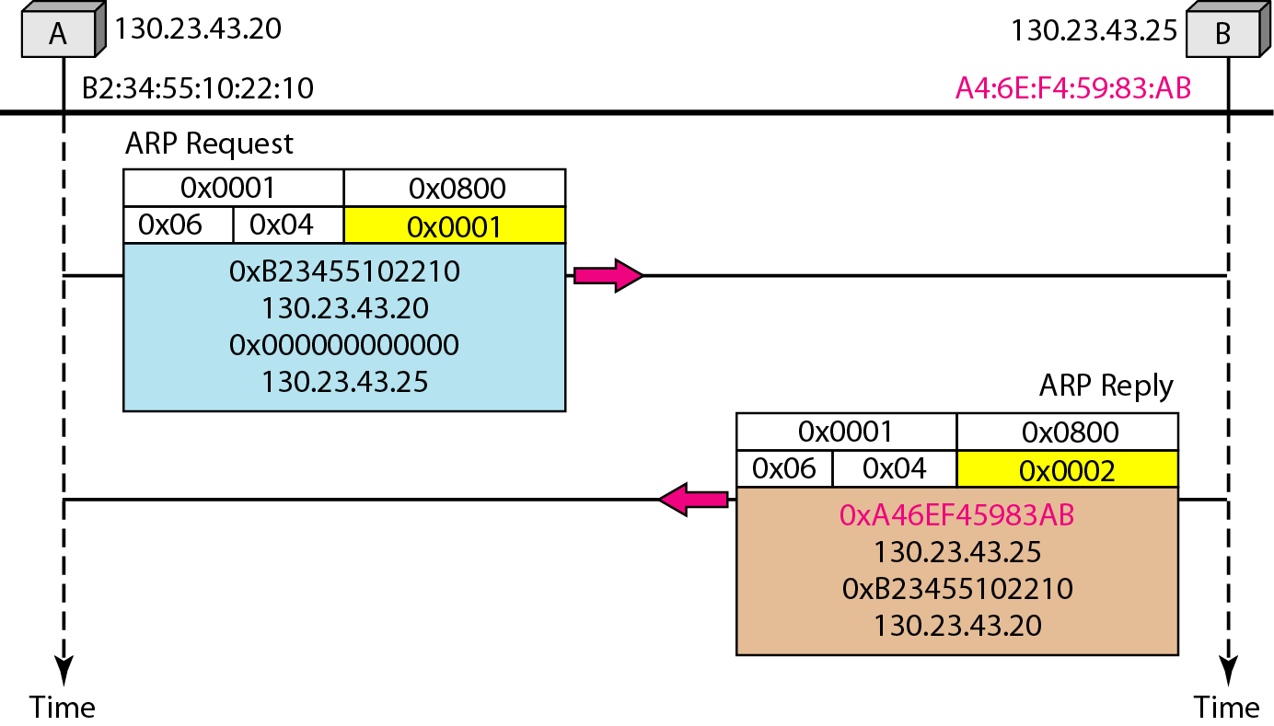
Figure 21.5 Example 21.1, an ARP request and reply

Slide 90
Mapping Physical to Logical Address: RARP, BOOTP, and DHCP
There are occasions in which a host knows its physical address, but needs to know its logical address. This may happen in two cases:
1. A diskless station is just booted. The station can find its physical address by checking its interface, but it does not know its IP address.
2. An organization does not have enough IP addresses to assign to each station; it needs to assign IP addresses on demand. The station can send its physical address and ask for a short time lease.

Slide 91
Reverse Address Resolution Protocol (RARP)
Finds the logical address for a machine that knows only its physical address.
To create an IP datagram, a host or a router needs to know its own IP address or addresses. The IP address of a machine is usually read from its configuration file stored on a disk file.
The machine can get its physical address (by reading its NIC, for example), which is unique locally. It can then use the physical address to get the logical address by using the RARP protocol.
A RARP request is created and broadcast on the local network.

Slide 92
Another machine on the local network that knows all the IP addresses will respond with a RARP reply. The requesting machine must be running a RARP client program; the responding machine must be running a RARP server program.
There is a serious problem with RARP: Broadcasting is done at the data link layer. The physical broadcast address, allis in the case of Ethernet, does not pass the boundaries of a network. This means that if an administrator has several networks or several subnets, it needs to assign a RARP server for each network or subnet. This is the reason that RARP is almost obsolete

Slide 93
ICMP
The IP protocol has no error-reporting or error-correcting mechanism. The IP protocol also lacks a mechanism for host and management queries. The Internet Control Message Protocol (ICMP) has been designed to compensate for the above two deficiencies. It is a companion to the IP protocol.

Slide 94
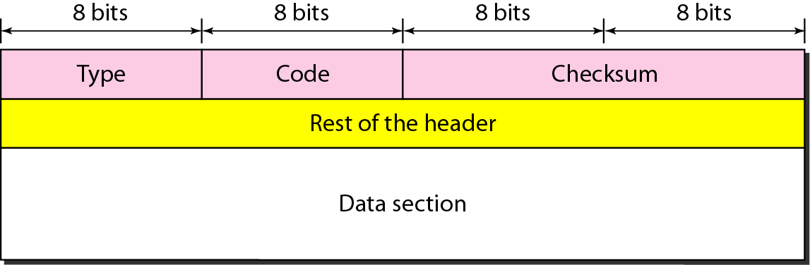
Figure 21.8 General format of ICMP messages

Slide 95
An ICMP message has an 8-byte header and variable size data section.
Two types of messages:
Error reporting messages
Query messages
The code field specifies the reason for the particular message type.
The last common field is the checksum field.
The rest of the header is specific for each message type.
The data section in error messages carries information for finding the original packet that had the error. In query messages, the data section carries extra information based on the type of the query

Slide 96
Note
ICMP always reports error messages to the original source.

Slide 97
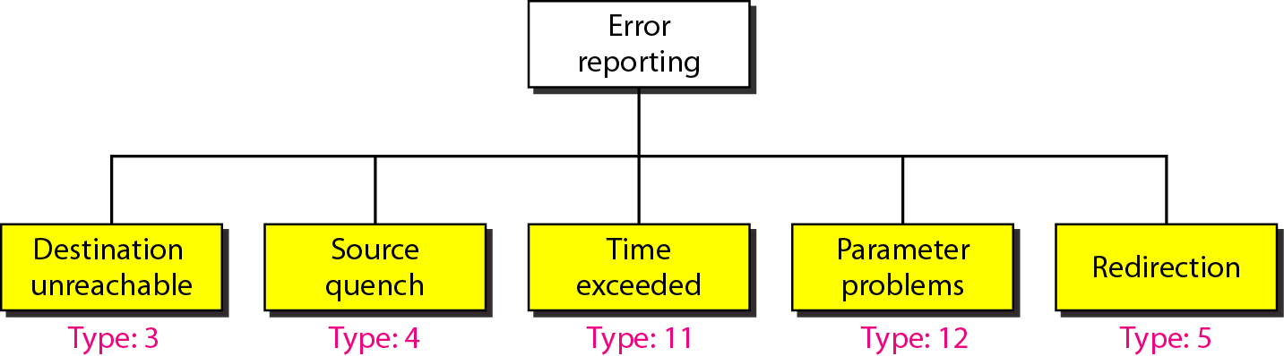
Figure 21.9 Error-reporting messages

Slide 98
The source-quench message in ICMP was designed to add a kind of flow control to the IP. When a router or host discards a datagram due to congestion, it sends a source-quench message to the sender of the datagram. This message has two purposes. First, it informs the source that the datagram has been discarded. Second, it warns the source that there is congestion somewhere in the path and that the source should slow down (quench) the sending process.
when the datagram is discarded, a time-exceeded message must be sent by the router to the original source. Second, a time-exceeded message is also generated when not all fragments that make up a message arrive at the destination host within a certain time limit.

Slide 99
Any ambiguity in the header part of a datagram can Create serious problems as the datagram travels through the Internet. If a router or the destination host discovers an ambiguous or missing value in any field of the datagram, it discards the datagram and sends a parameter-problem message back to the source.
The host may send a datagram, which is destined for another network, to the wrong router. In this case, the router that receives the datagram will forward the datagram to the correct router. However, to update the routing table of the host, it sends a redirection message to the host.

Slide 100
Note
Important points about ICMP error messages:
❏ No ICMP error message will be generated in response to a datagram carrying an ICMP error message.
❏ No ICMP error message will be generated for a fragmented datagram that is not the first fragment.
❏ No ICMP error message will be generated for a datagram having a multicast address.
❏ No ICMP error message will be generated for a datagram having a special address such as 127.0.0.0 or 0.0.0.0.

Slide 101
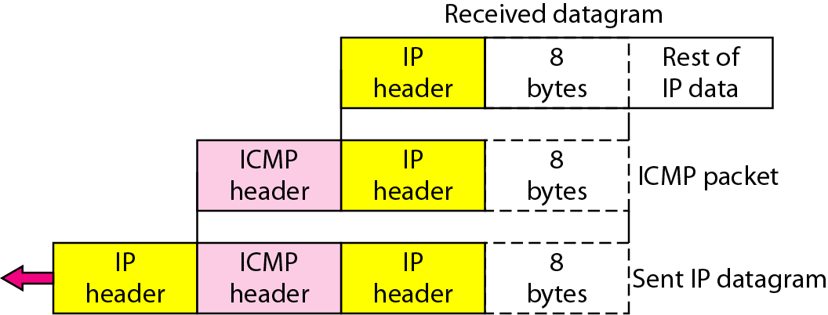
Figure 21.10 Contents of data field for the error messages

Slide 102
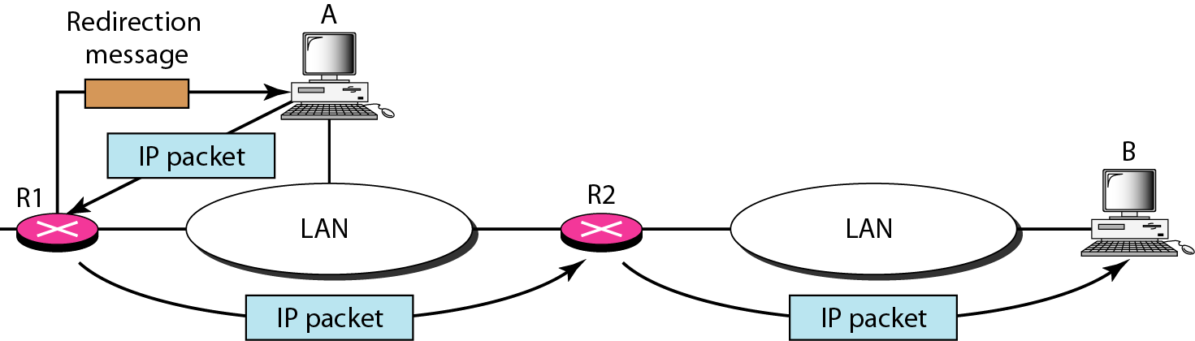
Figure 21.11 Redirection concept

Slide 103
In addition to error reporting, ICMP can diagnose some network problems. This is accomplished through the query messages, a group of four different pairs of messages
A query message is encapsulated in an IP packet, which in turn is encapsulated in a data link layer frame.
However, in this case, no bytes of the original IP are included in the message.

Slide 104
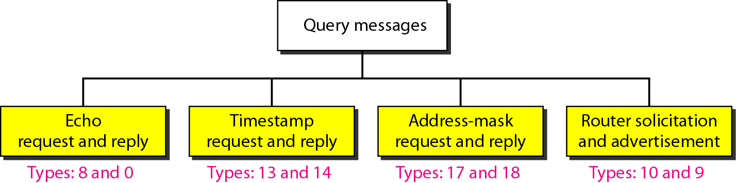
Figure 21.12 Query messages

Slide 105
Echo Request and Reply
The combination of echo-request and echo-reply messages determines whether two systems (hosts or routers) can communicate with each other.
ICMP messages are encapsulated in IP datagrams, the receipt of an echo-reply message by the machine that sent the echo request is proof that the IP protocols in the sender and receiver are communicating with each other using the IP datagram.
Also, it is proof that the intermediate routers are receiving, processing, and forwarding IP datagrams.
Today, most systems provide a version of the ping command that can create a series (instead of just one) of echo-request and echo-reply messages, providing statistical information

Slide 106
Timestamp Request and Reply
Two machines (hosts or routers) can use the timestamp request and timestamp reply messages to determine the round-trip time needed for an IP datagram to travel between them. It can also be used to synchronize the clocks in two machines.
Address-Mask Request and Reply
A host may know its IP address, but it may not know the corresponding mask. To obtain its mask, a host sends an address-mask-request message to a router on the LAN.
If the host knows the address of the router, it sends the request directly to the router. If it does not know, it broadcasts the message. The router receiving the address-mask-request message responds with an address-mask-reply message, providing the necessary mask for the host. This can be applied to its full IP address to get its subnet address.

Slide 107
Router Solicitation and Advertisement
The router-solicitation and router-advertisement messages are used to find the routers information.
A host can broadcast (or multicast) a router-solicitation message. The router or routers that receive the solicitation message broadcast their routing information using the router-advertisement message.
A router can also periodically send router-advertisement messages even if no host has solicited.
Checksum
In ICMP the checksum is calculated over the entire message (header and data).

Slide 108
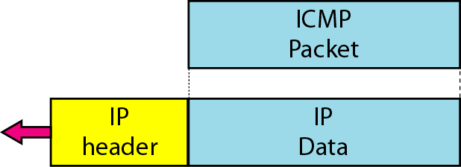
Figure 21.13 Encapsulation of ICMP query messages

Slide 109
Thank you!

